Slide 1
Auto-Shedding Control System
Presented by:
Nabin Bhattarai (070BCT522)
Dipesh Pandey (070BCT514)
Angad Gupta (070BCT506)

Slide 2
Objectives:
To use automatic system to generate the load-shedding schedule as per the requirement
To create a simple graphical interface to address the users
To make use of Nepali Date Format (Bikram Sambat) which is official date format using Date Converter
To target this program for NEA which requires to generate loadshedding schedules on regular basis and control automatically.

Slide 3
Background:
“Auto-shedding Control System” is a software which uses all the portion of c programming language.
We used Nepali date converter to convert AD date to BS date which is official date.
It can create load-shedding schedule and use it automatically and also the power control(on/off).
This is simply a concept that we can use computer in our power supply control system for the accuracy and high performance

Slide 4
Brief Algorithm Presentation:
Step 1: Start
Step 2: load main body of program
Step 3: Print menu to the user.
if user select make_ls_schedule
make ls schedule as per user requirement.
If user selects View LS schedule
show now loadshedding schedule to user.
If user selects Power Control
power on or off of a group as per requirement.
Step 4: end
Most of the functions used for the programs are defined under different header files. All these header files are included in the main.c file. Then required functions are directly used in it.

Slide 5
Work Division:
The main work division involved creating header files with the required functions by the members. We distributed our work on the basis of our different capabilities.
The graphics portions included creation of the functions under graphics_lib.h, TXT.h, and xnMenu.h header files.
The show_now_loadshedding.h and Autoshedding.h included writing the functions for Tabbed view of the schedule and create and save loadshedding schedule to a specific file.
The ls.h header included functions for automating the schedule which provide some basic funtions for the time handeling and loadshedding group’s data handeling.
We worked together for DateConverter.h and the main.c file and completed the whole of the programming.

Slide 6
List of Problems:
There was a problem to use graphics in Codeblocks IDE(gcc compiler) which especially does not provide graphics library for 32 bit c program.
There was some error on the date converter which was due to some mistake on calculation and debugged by checking the output.

Slide 7
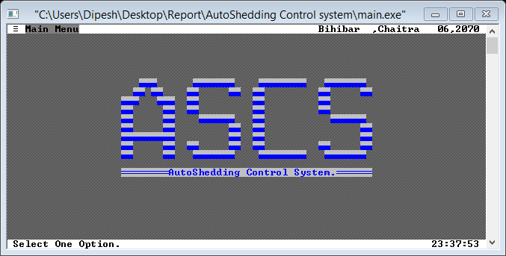
Output:
1. The starting window of the program

Slide 8
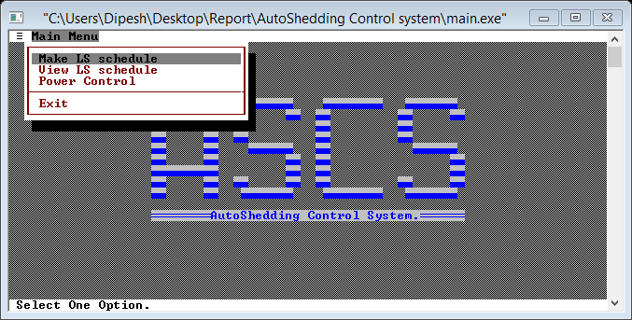
2. The Main menu

Slide 9
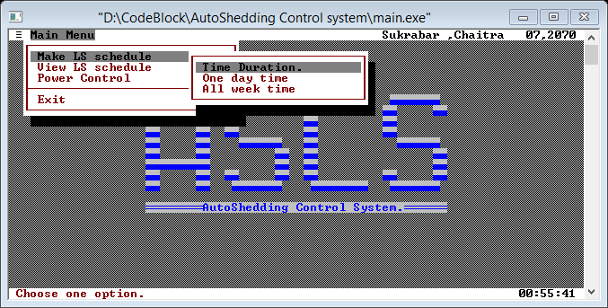
3. Popup menu for menu Make ls Schedule.

Slide 10
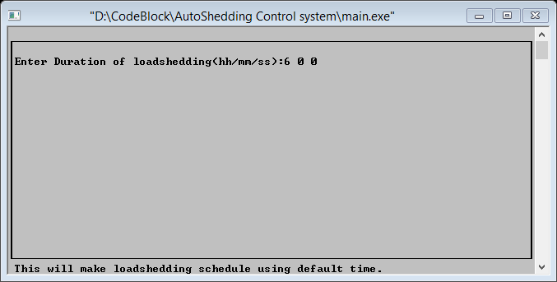
User input window for loadshedding time duration a day

Slide 11
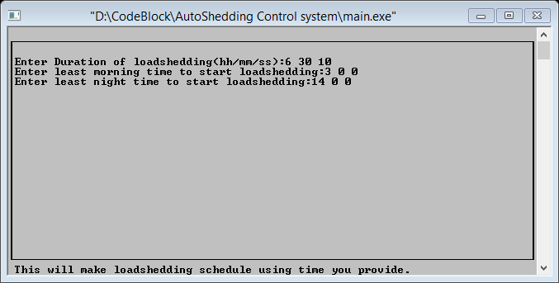
User input box for the input of :
Time duration for the loadshedding per day.
The minimum time in morning to start loadshedding.
The minimum time in night(day) to start loadshedding.

Slide 12
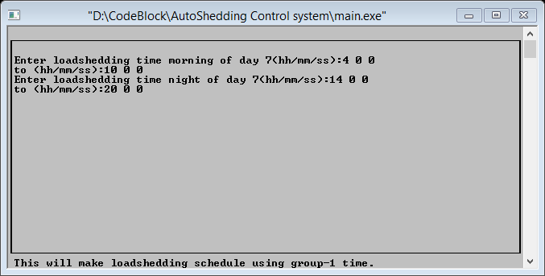
This is the user input box to receive all morning and night loadshedding time by user for the week for group-1.
Other group’s schedule will be created using group-1 loadshedding time.

Slide 13
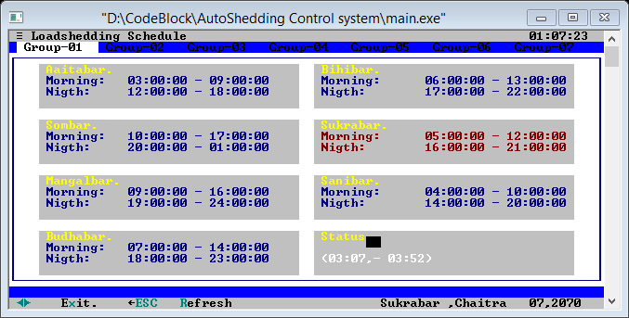
Menu option View ls schedule:
It shows the loadshedding schedule of all group using tabs.

Slide 14
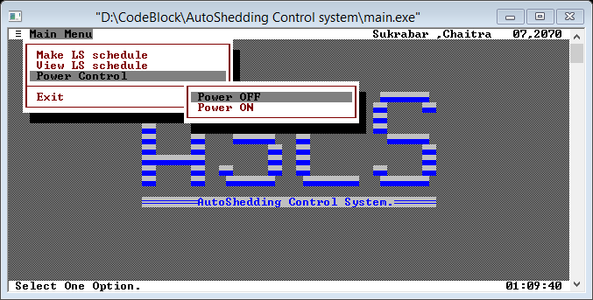
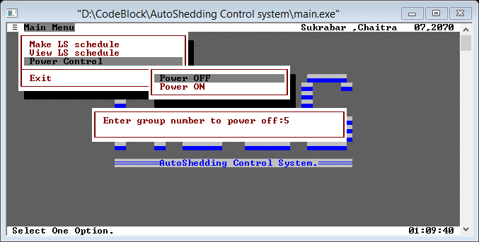
This is to control the power of a group.(to turn on or turn off the power supply)

Slide 15
Thank you!

